Slide 1
Python Programming
Unit -5 : Python Database and GUI Programming
Topics : Python’s Database Connectivity, Working with MySQL Database, Using MySQL from python, Creating Database tables through python, Retrieving all the rows from the table, Inserting rows in the table, Deleting the rows from the table, Updating Rows in a table, Python’s GUI Programming.

Slide 2
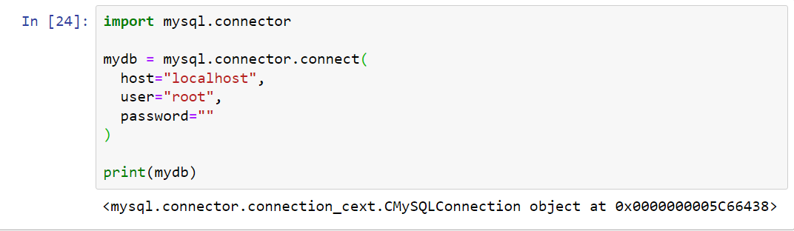
MySQL Connectivity
To create a connection between the MySQL database and the python application, the connect() method of mysql.connector module is used.
Pass the database details like HostName, username, and the database password in the method call. The method returns the connection object.

Slide 3

Create Database
The MySQLCursor of mysql-connector-python (and similar libraries) is used to execute statements to communicate with the MySQL database.
Using the methods of it you can execute SQL statements, fetch data from the result sets, call procedures.
You can create Cursor object using the cursor() method of the Connection object/class.
To create a database in MySQL, use the "CREATE DATABASE" statement:

Slide 4
Methods in Cursor (information)
Sr.No | Method & Description
1 | callproc() This method is used to call existing procedures MySQL database.
2 | close() This method is used to close the current cursor object.
3 | Info() This method gives information about the last query.
4 | executemany() This method accepts a list series of parameters list. Prepares an MySQL query and executes it with all the parameters.
5 | execute() This method accepts a MySQL query as a parameter and executes the given query.
6 | fetchall() This method retrieves all the rows in the result set of a query and returns them as list of tuples. (If we execute this after retrieving few rows it returns the remaining ones)
7 | fetchone() This method fetches the next row in the result of a query and returns it as a tuple.
8 | fetchmany() This method is similar to the fetchone() but, it retrieves the next set of rows in the result set of a query, instead of a single row.
9 | fetchwarnings() This method returns the warnings generated by the last executed query.

Slide 5
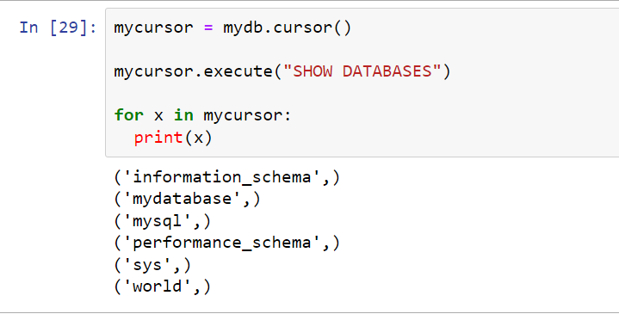
Show Database
You can check if a database exist by listing all databases in your system by using the "SHOW DATABASES" statement:

Slide 6
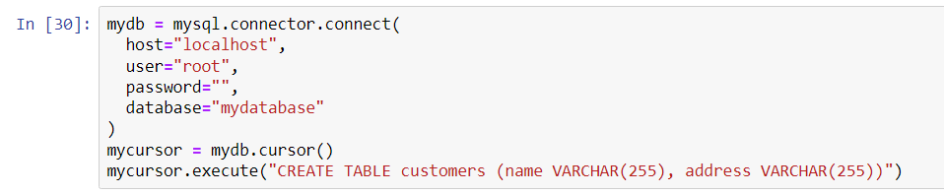
Create Table
To create a table in MySQL, use the "CREATE TABLE" statement.
Make sure you define the name of the database when you create the connection.

Slide 7
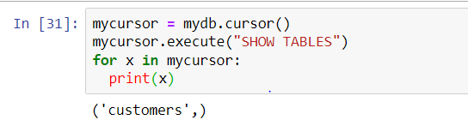
Table Exist or Not
You can check if a table exist by listing all tables in your database with the "SHOW TABLES" statement:

Slide 8
Primary Key and Alter Table
You can check if a table exist by listing all tables in your database with the "SHOW TABLES" statement:
Example-1
mycursor = mydb.cursor() mycursor.execute("CREATE TABLE customers (id INT AUTO_INCREMENT PRIMARY KEY, name VARCHAR(255), address VARCHAR(255))")
Example-2
mycursor = mydb.cursor() mycursor.execute("ALTER TABLE customers ADD COLUMN id INT AUTO_INCREMENT PRIMARY KEY")

Slide 9
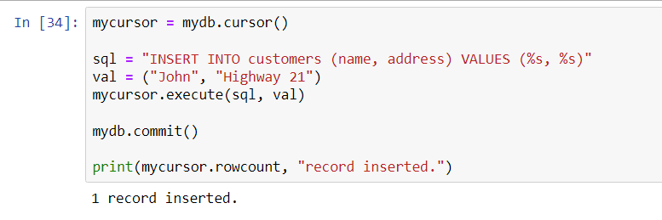
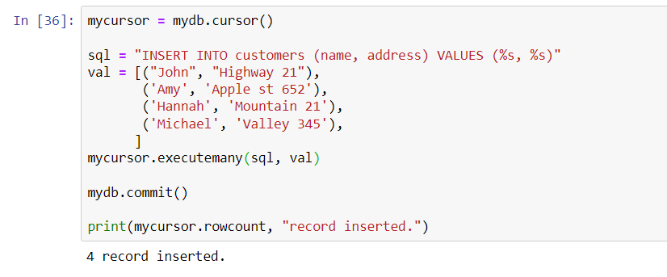
Insert into Table
To fill a table in MySQL, use the "INSERT INTO" statement. Executemany command is use to insert more than one values

Slide 10
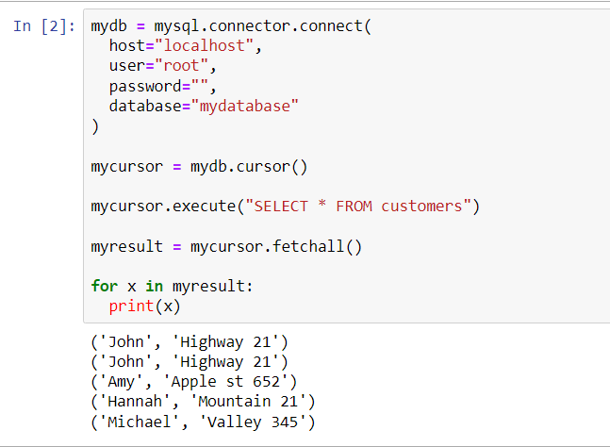
Retrieving Rows from Table
To select from a table in MySQL, use the "SELECT" statement:

Slide 11
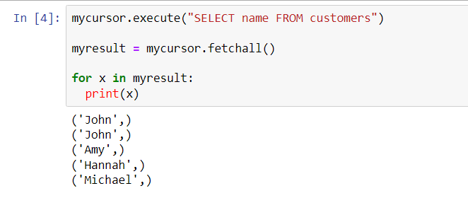
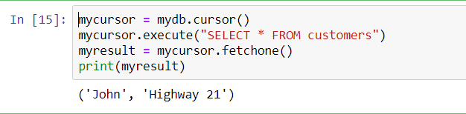
Select from Table
To select only some of the columns in a table, use the "SELECT" statement followed by the column name(s):
If you are only interested in one row, you can use the fetchone() method. The fetchone() method will return the first row of the result.

Slide 12
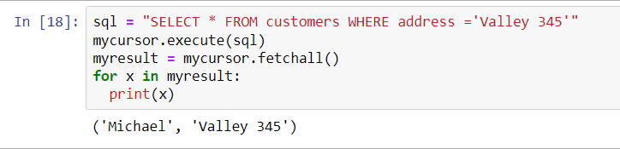
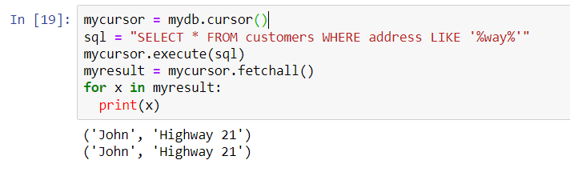
Select from Table
When selecting records from a table, you can filter the selection by using the "WHERE" statement:
You can also select the records that starts, includes, or ends with a given letter or phrase. Use the % to represent wildcard characters:

Slide 13
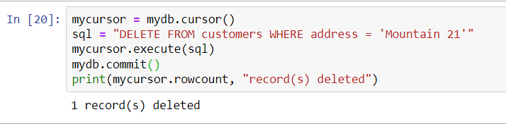
Delete from Table
You can delete records from an existing table by using the "DELETE FROM" statement:
Note : The statement mydb.commit(). It is required to make the changes, otherwise no changes are made to the table.

Slide 14


Drop Table
You can delete an existing table by using the "DROP TABLE" statement:
If the table you want to delete is already deleted, or for any other reason does not exist, you can use the IF EXISTS keyword to avoid getting an error.

Slide 15
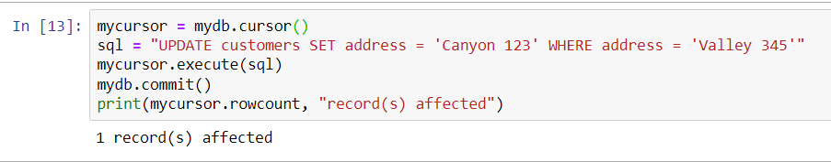
Update Data in Table
You can update existing records in a table by using the "UPDATE" statement:
It is considered a good practice to escape the values of any query, also in update statements.
This is to prevent SQL injections, which is a common web hacking technique to destroy or misuse your database.
The mysql.connector module uses the placeholder %s to escape values in the delete statement:

Slide 16
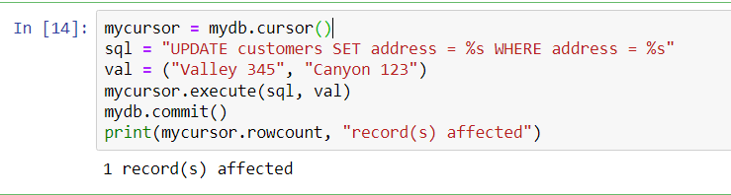
Update Data in Table

Slide 17
Python GUI – Tkinter
Python offers multiple options for developing GUI (Graphical User Interface). Out of all the GUI methods, tkinter is the most commonly used method.
It is a standard Python interface to the Tk GUI toolkit shipped with Python.
Python with tkinter is the fastest and easiest way to create the GUI applications. Creating a GUI using tkinter is an easy task.
To create a tkinter app:
Importing the module – tkinter
Create the main window (container)
Add any number of widgets to the main window
Apply the event Trigger on the widgets.
Importing tkinter is same as importing any other module in the Python code : import tkinter

Slide 18
Python GUI – Tkinter
There are two main methods used which the user needs to remember while creating the Python application with GUI.
Tk()-To change the name of the window, you can change the className to the desired one. The basic code used to create the main window of the application is:
m=tkinter.Tk() where m is the name of the main window object
mainloop(): There is a method known by the name mainloop() is used when your application is ready to run. mainloop() is an infinite loop used to run the application, wait for an event to occur and process the event as long as the window is not closed.
m.mainloop()

Slide 19
Python GUI – Tkinter
Example:
import tkinter
m = tkinter.Tk()
'''
widgets are added here
'''
m.mainloop()
tkinter also offers access to the geometric configuration of the widgets which can organize the widgets in the parent windows. There are mainly three geometry manager classes class.
pack() method:It organizes the widgets in blocks before placing in the parent widget.
grid() method:It organizes the widgets in grid (table-like structure) before placing in the parent widget.
place() method:It organizes the widgets by placing them on specific positions directed by the programmer.

Slide 20
Button
There are a number of widgets which you can put in your tkinter application. Some of the major widgets are explained below:
Button: To add a button in your application, this widget is used.
The general syntax is:
w=Button(master, option=value)
master is the parameter used to represent the parent window.
There are number of options which are used to change the format of the Buttons. Number of options can be passed as parameters separated by commas.
activebackground: to set the background color when button is under the cursor.
activeforeground: to set the foreground color when button is under the cursor.
bg: to set the normal background color.
command: to call a function.
font: to set the font on the button label.
image: to set the image on the button.
width: to set the width of the button.
height: to set the height of the button.

Slide 21

Button
Example:
import tkinter as tk
r = tk.Tk()
r.title('Counting Seconds')
button = tk.Button(r, text='Stop', width=25, command=r.destroy)
button.pack()
r.mainloop()
Output:

Slide 22
Canvas
There are a number of widgets which you can put in your tkinter application. Some of the major widgets are explained below:
Canvas: It is used to draw pictures and other complex layout like graphics, text and widgets.
The general syntax is:
w = Canvas(master, option=value)
master is the parameter used to represent the parent window.
There are number of options which are used to change the format of the widgets. Number of options can be passed as parameters separated by commas.
bd: to set the border width in pixels.
bg: to set the normal background color.
cursor: to set the cursor used in the canvas.
highlightcolor: to set the color shown in the focus highlight.
width: to set the width of the widget.
height: to set the height of the widget.

Slide 23
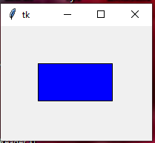
Canvas
Example:
from tkinter import *
root = Tk()
canvas = Canvas(root, width=200, height=150)
canvas.pack()
# Draw a rectangle (x1, y1, x2, y2)
canvas.create_rectangle(50, 50, 150, 100, fill="blue")
root.mainloop()
Output:

Slide 24
What is IntVar() in Tkinter?
IntVar() is a special Tkinter variable that stores an integer value. It is commonly used to track the state of widgets like Checkbuttons and Radiobuttons.
Why Use IntVar() Instead of a Normal Variable?
Automatic Updates → When the widget value changes, IntVar() updates automatically.
Easy Data Retrieval → Use .get() to read the current value.
Dynamic Binding → Can be linked to multiple widgets.

Slide 25
Example-
from tkinter import *
root = Tk()
# Create an IntVar to track checkbox state
var = IntVar()
# Create a checkbox linked to the IntVar
chk = Checkbutton(root, text="Check Me!", variable=var)
chk.pack()
# Function to display checkbox state
def show_state():
print(f"Checked: {var.get()}") # 1 if checked, 0 if unchecked
# Button to check the value of IntVar
btn = Button(root, text="Show Value", command=show_state)
btn.pack()
root.mainloop()

Slide 26
CheckButton
CheckButton: To select any number of options by displaying a number of options to a user as toggle buttons.
The general syntax is:
w = Checkbutton(master, option=value)
master is the parameter used to represent the parent window.
There are number of options which are used to change the format of the widgets. Number of options can be passed as parameters separated by commas.
Title: To set the title of the widget.
activebackground: to set the background color when widget is under the cursor.
activeforeground: to set the foreground color when widget is under the cursor.
command: to call a function.
font: to set the font on the button label.
image: to set the image on the widget.

Slide 27

CheckButton
Example:
from tkinter import *
master = Tk()
var1 = IntVar()
Checkbutton(master, text='male', variable=var1).grid(row=0, sticky=W)
var2 = IntVar()
Checkbutton(master, text='female', variable=var2).grid(row=1, sticky=W)
mainloop()
Output:

Slide 28
RadioButton
RadioButton: It is used to offer multi-choice option to the user. It offers several options to the user and the user has to choose one option.
The general syntax is:
w = Radiobutton(master, option=value)
master is the parameter used to represent the parent window.
There are number of options which are used to change the format of the widgets. Number of options can be passed as parameters separated by commas.
activebackground: to set the background color when widget is under the cursor.
activeforeground: to set the foreground color when widget is under the cursor.
bg: to set the normal background color.
command: to call a function.
font: to set the font on the button label.
image: to set the image on the widget.
width: to set the width of the label in characters.
height: to set the height of the label in characters.

Slide 29

RadioButton
Example:
from tkinter import *
root = Tk()
v = IntVar()
Radiobutton(root, text='GfG', variable=v, value=1).pack(anchor=W)
Radiobutton(root, text='MIT', variable=v, value=2).pack(anchor=W)
mainloop()
Output:

Slide 30
Entry
Entry:It is used to input the single line text entry from the user.. For multi-line text input, Text widget is used. The general syntax is:
w=Entry(master, option=value)
master is the parameter used to represent the parent window.
There are number of options which are used to change the format of the widgets. Number of options can be passed as parameters separated by commas.
bd: to set the border width in pixels.
bg: to set the normal background color.
cursor: to set the cursor used.
command: to call a function.
highlightcolor: to set the color shown in the focus highlight.
width: to set the width of the button.
height: to set the height of the button.

Slide 31

Entry
Example:
from tkinter import *
master = Tk()
Label(master, text='First Name').grid(row=0)
Label(master, text='Last Name').grid(row=1)
e1 = Entry(master)
e2 = Entry(master)
e1.grid(row=0, column=1)
e2.grid(row=1, column=1)
mainloop()
Output:

Slide 32
Label
Label: It refers to the display box where you can put any text or image which can be updated any time as per the code.
The general syntax is:
w=Label(master, option=value)
master is the parameter used to represent the parent window.
There are number of options which are used to change the format of the widgets. Number of options can be passed as parameters separated by commas.
bg: to set the normal background color.
command: to call a function.
font: to set the font on the button label.
image: to set the image on the button.
width: to set the width of the button.
height” to set the height of the button.

Slide 33

Entry
Example:
from tkinter import *
root = Tk()
w = Label(root, text='Hello Everyone!!!')
w.pack()
root.mainloop()
Output:

